Slide 1
DBSCAN

Slide 2
Outline
What is DBSCAN?
How DBSCAN works

Slide 3
What is DBSCAN?
Density-Based Spatial Clustering of Applications with Noise is a density-based clustering technique that groups data points based on their density and proximity to each other.

Slide 4
What is DBSCAN?
It forms clusters by identifying core points and expanding them to reach neighboring points.
Points not part of any cluster are classified as noise or outliers.

Slide 5
For example, if we have an unlabeled data set with Height and Weight measurements collected from a group of people…
Height | Weight
56 | 150
62 | 170
71 | 168
76 | 171
… | …

Slide 6
And plotted the data in a scatter plot..
Weight
Height

Slide 7
By eye, we can see two different clusters and some outliers
Outlier
Weight
Outlier
Outlier
Outlier
Height

Slide 8
If we use K-Means to partition nested clusters like in this example, it might have difficulty identifying these two clusters
Weight
Height

Slide 9
DBSCAN can help us handle nested clusters
Weight
Height

Slide 10
DBSCAN can also identify nested clusters in higher dimensions (3-dimensions, 4-dimensions)
Weight
Age
Height

Slide 11
DBSCAN tries to mimic what we can do by eye
Weight
Height

Slide 12
By eye, we identify clusters by the densities of the points
Clusters are in high density regions
Weight
Height

Slide 13
By eye, we identify clusters by the densities of the points
Outliers are in low density regions
Weight
Height

Slide 14
Let us see DBSCAN in action!
Weight
Height

Slide 15
Step 1: First, we count the number of points close to each point
Weight
Height

Slide 16
For example, if we start at this red point and draw a circle around it
Weight
Height

Slide 17
We can see that the circle overlaps at least partially 6 other points. So the red point is close to 6 other points
Weight
Height
Notes:
Have you asked yourself the question, why do people organize?
Lets go to the psychology of organizing
This predictability applies within the context of our homes, manifesting through the concept of organization

Slide 18
The radius of this red circle is user defined. This is a hyperparameter that we can adjust or fiddle around.
Weight
Height

Slide 19
Likewise, for all the remaining points, we count the number of close points.
Weight
Height

Slide 20
In this example, we will define a core point to be one that is close to at least 4 other points
Weight
Height

Slide 21
The number of close points in a core point is user defined. This is a hyperparameter that we can adjust or fiddle around like the radius.
Weight
Height

Slide 22
In this example, these 3 points are some of our core points because their red circles overlaps at least four other points.
Weight
Height

Slide 23
And neither of these points are core points because their red circles do not overlap at least 4 points
Weight
Height

Slide 24
Ultimately, we identify all red points as core points because they are all close to four other points
Weight
Height

Slide 25
And the remaining points are non-core points.
Weight
Height

Slide 26
Now, we randomly pick a core point
Weight
Height

Slide 27
Now, we randomly pick a core point
Weight
Height

Slide 28
Next, the core points that are close to the first cluster,
Weight
Height

Slide 29
Are added to the first cluster
Weight
Height

Slide 30
Are added to the first cluster
Weight
Height

Slide 31
Are added to the first cluster
Weight
Height

Slide 32
Are added to the first cluster
Weight
Height

Slide 33
Are added to the first cluster
Weight
Height

Slide 34
Are added to the first cluster
Weight
Height

Slide 35
Are added to the first cluster
Weight
Height

Slide 36
Are added to the first cluster
Weight
Height

Slide 37
Are added to the first cluster
Weight
Height

Slide 38
Are added to the first cluster
Weight
Height

Slide 39
Are added to the first cluster
Weight
Height

Slide 40
Are added to the first cluster
Weight
Height

Slide 41
Are added to the first cluster
Weight
Height
Notes:
Have you asked yourself the question, why do people organize?
Lets go to the psychology of organizing
This predictability applies within the context of our homes, manifesting through the concept of organization

Slide 42
At this point, every single point in the first cluster is a core point
Weight
Height

Slide 43
Next, we add the non-core points to the first cluster
Weight
Height

Slide 44
For example, this non-core point is close to a core point in the first cluster
Weight
Height

Slide 45
However, because this is non-core point, we do not use it to extend the first cluster any further.
Weight
Height

Slide 46
So this non-core point will not be added to the first cluster.
Weight
Height

Slide 47
Unlike core points, non-core points can only join a cluster. They can not extend it further.
Weight
Height

Slide 48
Now, we add all non-core points that are close to the core points in the first cluster to the cluster.
Weight
Height

Slide 49
And now we are done creating the first cluster.
Weight
Height

Slide 50
Now, because none of these core points are close to the first cluster,
Weight
Height

Slide 51
They form a new second cluster because they are close to each other.
Weight
Height

Slide 52
And the non-core points that are close to the second cluster are added to it.
Weight
Height

Slide 53
And the non-core points that are close to the second cluster are added to it.
Weight
Height

Slide 54
Because all core points have been assigned to a cluster, we are done clustering!
Weight
Height

Slide 55
Any remaining non-core points that are not close to core-points are not added to clusters and are called outliers
Weight
Height

Slide 56
And that is how the DBSCAN algorithm works!
Weight
Height

Slide 57
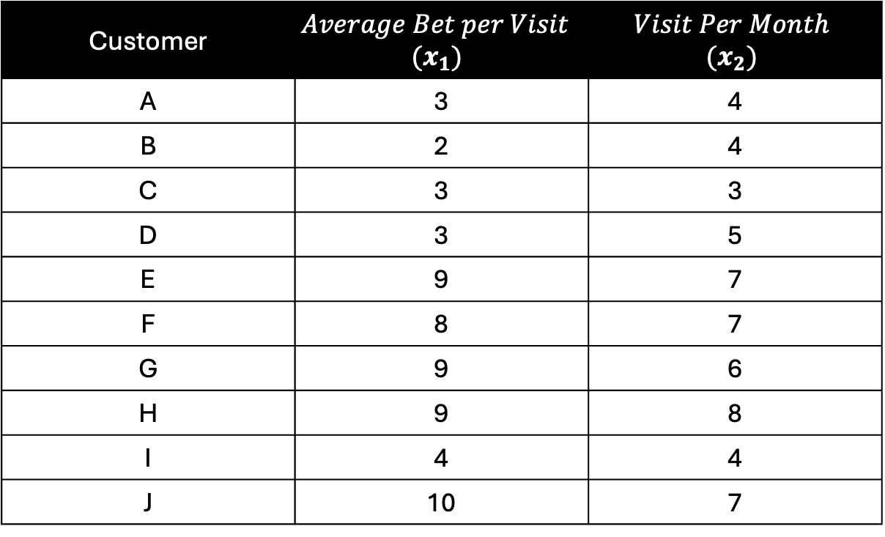
Customer | $$Average Bet per Visit$$ $$(x_{1})$$ | $$Visit Per Month$$ $${(x}_{2})$$
A | 3 | 4
B | 2 | 4
C | 3 | 3
D | 3 | 5
E | 9 | 7
F | 8 | 7
G | 9 | 6
H | 9 | 8
I | 4 | 4
J | 10 | 7

Slide 58
eps is the maximum distance between two samples for one to be considered as in the neighborhood of the other.
F
E
J
D
B
A
I
C
Step 1: Set eps and min_samples

Slide 59
min_samples is the number of samples in a neighborhood for a point to be considered as a core point.
This includes the point itself.
If min_samples is set to a higher value, DBSCAN will find denser clusters, whereas if it is set to a lower value, the found clusters will be more sparse.
F
E
J
D
B
A
I
C
Step 1: Set eps and min_samples

Slide 60
For this example, we will set
eps = 1
and
min_samples = 4
F
E
J
D
B
A
I
C
Step 1: Set eps and min_samples

Slide 61
 | A (3,4) | B (2,4) | C (3,3) | D (3,5) | E (9,7) | F (8,7) | G (9,6) | H (9,8) | I (4,4) | J (10,7)
A (3,4) | 0 | 1 | 1 | 1 | 6.7 | 9.8 | 6.3 | 7.2 | 1 | 7.6
B (2,4) | 1 | 0 | 1.4 | 1.4 | 7.6 | 6.7 | 7.2 | 8 | 2 | 8.5
C (3,3) | 1 | 1.4 | 0 | 2 | 7.2 | 6.4 | 6.7 | 7.8 | 1.4 | 8
D (3,5) | 1 | 1.4 | 2 | 0 | 6.3 | 5.3 | 6 | 6.7 | 1.4 | 7.2
E (9,7) | 6.7 | 7.6 | 7.2 | 6.3 | 0 | 1 | 1 | 1 | 5.8 | 1
F (8,7) | 9.8 | 6.7 | 6.4 | 5.3 | 1 | 0 | 1.4 | 1.4 | 5 | 2
G (9,6) | 6.3 | 7.2 | 6.7 | 6 | 1 | 1.4 | 0 | 2 | 5.3 | 1.4
H (9,8) | 7.2 | 8 | 7.8 | 6.7 | 1 | 1.4 | 2 | 0 | 6.4 | 1.4
I (4,4) | 1 | 2 | 1.4 | 1.4 | 5.8 | 5 | 5.3 | 6.4 | 0 | 6.7
J (10,7) | 7.6 | 8.5 | 8 | 7.2 | 1 | 2 | 1.4 | 1.4 | 6.7 | 0
F
E
J
D
B
A
I
C
Step 2: Calculate the distance between every pair of data points using a distance metric like Euclidean distance.

Slide 62
 | A (3,4) | B (2,4) | C (3,3) | D (3,5) | E (4,4) | F (8,7) | G (9,6) | H (9,8) | I (9,7) | J (10,7)
A (3,4) | 0 | 1 | 1 | 1 | 1 | 5.8 | 6.3 | 7.2 | 6.7 | 7.6
B (2,4) | 1 | 0 | 1.4 | 1.4 | 2 | 6.7 | 7.2 | 8 | 7.6 | 8.5
C (3,3) | 1 | 1.4 | 0 | 2 | 1.4 | 6.4 | 6.7 | 7.8 | 7.2 | 8
D (3,5) | 1 | 1.4 | 2 | 0 | 1.4 | 5.3 | 6 | 6.7 | 6.3 | 7.2
E (4,4) | 1 | 2 | 1.4 | 1.4 | 0 | 5 | 5.3 | 6.4 | 5.8 | 6.7
F (8,7) | 5.8 | 6.7 | 6.4 | 5.3 | 5 | 0 | 1.4 | 1.4 | 1 | 2
G (9,6) | 6.3 | 7.2 | 6.7 | 6 | 5.3 | 1.4 | 0 | 2 | 1 | 1.4
H (9,8) | 7.2 | 8 | 7.8 | 6.7 | 6.4 | 1.4 | 2 | 0 | 1 | 1.4
I (9,7) | 6.7 | 7.6 | 7.2 | 6.3 | 5.8 | 1 | 1 | 1 | 0 | 1
J (10,7) | 7.6 | 8.5 | 8 | 7.2 | 6.7 | 2 | 1.4 | 1.4 | 1 | 0
F
I
J
D
B
A
E
C
Step 3: For each point, find its neighbours within the eps/radius.

Slide 63
 | A (3,4) | B (2,4) | C (3,3) | D (3,5) | E (4,4) | F (8,7) | G (9,6) | H (9,8) | I (9,7) | J (10,7)
A (3,4) | 0 | 1 | 1 | 1 | 1 | 5.8 | 6.3 | 7.2 | 6.7 | 7.6
B (2,4) | 1 | 0 | 1.4 | 1.4 | 2 | 6.7 | 7.2 | 8 | 7.6 | 8.5
C (3,3) | 1 | 1.4 | 0 | 2 | 1.4 | 6.4 | 6.7 | 7.8 | 7.2 | 8
D (3,5) | 1 | 1.4 | 2 | 0 | 1.4 | 5.3 | 6 | 6.7 | 6.3 | 7.2
E (4,4) | 1 | 2 | 1.4 | 1.4 | 0 | 5 | 5.3 | 6.4 | 5.8 | 6.7
F (8,7) | 5.8 | 6.7 | 6.4 | 5.3 | 5 | 0 | 1.4 | 1.4 | 1 | 2
G (9,6) | 6.3 | 7.2 | 6.7 | 6 | 5.3 | 1.4 | 0 | 2 | 1 | 1.4
H (9,8) | 7.2 | 8 | 7.8 | 6.7 | 6.4 | 1.4 | 2 | 0 | 1 | 1.4
I (9,7) | 6.7 | 7.6 | 7.2 | 6.3 | 5.8 | 1 | 1 | 1 | 0 | 1
J (10,7) | 7.6 | 8.5 | 8 | 7.2 | 6.7 | 2 | 1.4 | 1.4 | 1 | 0
F
I
J
D
B
A
E
C
Step 3: For each point, find its neighbours within the eps/radius.

Slide 64
 | A (3,4) | B (2,4) | C (3,3) | D (3,5) | E (4,4) | F (8,7) | G (9,6) | H (9,8) | I (9,7) | J (10,7)
A (3,4) | 0 | 1 | 1 | 1 | 1 | 5.8 | 6.3 | 7.2 | 6.7 | 7.6
B (2,4) | 1 | 0 | 1.4 | 1.4 | 2 | 6.7 | 7.2 | 8 | 7.6 | 8.5
C (3,3) | 1 | 1.4 | 0 | 2 | 1.4 | 6.4 | 6.7 | 7.8 | 7.2 | 8
D (3,5) | 1 | 1.4 | 2 | 0 | 1.4 | 5.3 | 6 | 6.7 | 6.3 | 7.2
E (4,4) | 1 | 2 | 1.4 | 1.4 | 0 | 5 | 5.3 | 6.4 | 5.8 | 6.7
F (8,7) | 5.8 | 6.7 | 6.4 | 5.3 | 5 | 0 | 1.4 | 1.4 | 1 | 2
G (9,6) | 6.3 | 7.2 | 6.7 | 6 | 5.3 | 1.4 | 0 | 2 | 1 | 1.4
H (9,8) | 7.2 | 8 | 7.8 | 6.7 | 6.4 | 1.4 | 2 | 0 | 1 | 1.4
I (9,7) | 6.7 | 7.6 | 7.2 | 6.3 | 5.8 | 1 | 1 | 1 | 0 | 1
J (10,7) | 7.6 | 8.5 | 8 | 7.2 | 6.7 | 2 | 1.4 | 1.4 | 1 | 0
F
I
J
D
B
A
E
C
Step 3: For each point, find its neighbours within the eps/radius.

Slide 65
 | A (3,4) | B (2,4) | C (3,3) | D (3,5) | E (4,4) | F (8,7) | G (9,6) | H (9,8) | I (9,7) | J (10,7)
A (3,4) | 0 | 1 | 1 | 1 | 1 | 5.8 | 6.3 | 7.2 | 6.7 | 7.6
B (2,4) | 1 | 0 | 1.4 | 1.4 | 2 | 6.7 | 7.2 | 8 | 7.6 | 8.5
C (3,3) | 1 | 1.4 | 0 | 2 | 1.4 | 6.4 | 6.7 | 7.8 | 7.2 | 8
D (3,5) | 1 | 1.4 | 2 | 0 | 1.4 | 5.3 | 6 | 6.7 | 6.3 | 7.2
E (4,4) | 1 | 2 | 1.4 | 1.4 | 0 | 5 | 5.3 | 6.4 | 5.8 | 6.7
F (8,7) | 5.8 | 6.7 | 6.4 | 5.3 | 5 | 0 | 1.4 | 1.4 | 1 | 2
G (9,6) | 6.3 | 7.2 | 6.7 | 6 | 5.3 | 1.4 | 0 | 2 | 1 | 1.4
H (9,8) | 7.2 | 8 | 7.8 | 6.7 | 6.4 | 1.4 | 2 | 0 | 1 | 1.4
I (9,7) | 6.7 | 7.6 | 7.2 | 6.3 | 5.8 | 1 | 1 | 1 | 0 | 1
J (10,7) | 7.6 | 8.5 | 8 | 7.2 | 6.7 | 2 | 1.4 | 1.4 | 1 | 0
F
I
J
D
B
A
E
C
Step 3: For each point, find its neighbours within the eps/radius.

Slide 66
 | A (3,4) | B (2,4) | C (3,3) | D (3,5) | E (4,4) | F (8,7) | G (9,6) | H (9,8) | I (9,7) | J (10,7)
A (3,4) | 0 | 1 | 1 | 1 | 1 | 5.8 | 6.3 | 7.2 | 6.7 | 7.6
B (2,4) | 1 | 0 | 1.4 | 1.4 | 2 | 6.7 | 7.2 | 8 | 7.6 | 8.5
C (3,3) | 1 | 1.4 | 0 | 2 | 1.4 | 6.4 | 6.7 | 7.8 | 7.2 | 8
D (3,5) | 1 | 1.4 | 2 | 0 | 1.4 | 5.3 | 6 | 6.7 | 6.3 | 7.2
E (4,4) | 1 | 2 | 1.4 | 1.4 | 0 | 5 | 5.3 | 6.4 | 5.8 | 6.7
F (8,7) | 5.8 | 6.7 | 6.4 | 5.3 | 5 | 0 | 1.4 | 1.4 | 1 | 2
G (9,6) | 6.3 | 7.2 | 6.7 | 6 | 5.3 | 1.4 | 0 | 2 | 1 | 1.4
H (9,8) | 7.2 | 8 | 7.8 | 6.7 | 6.4 | 1.4 | 2 | 0 | 1 | 1.4
I (9,7) | 6.7 | 7.6 | 7.2 | 6.3 | 5.8 | 1 | 1 | 1 | 0 | 1
J (10,7) | 7.6 | 8.5 | 8 | 7.2 | 6.7 | 2 | 1.4 | 1.4 | 1 | 0
F
I
J
D
B
A
E
C
Step 3: For each point, find its neighbours within the eps/radius.

Slide 67
 | A (3,4) | B (2,4) | C (3,3) | D (3,5) | E (4,4) | F (8,7) | G (9,6) | H (9,8) | I (9,7) | J (10,7)
A (3,4) | 0 | 1 | 1 | 1 | 1 | 5.8 | 6.3 | 7.2 | 6.7 | 7.6
B (2,4) | 1 | 0 | 1.4 | 1.4 | 2 | 6.7 | 7.2 | 8 | 7.6 | 8.5
C (3,3) | 1 | 1.4 | 0 | 2 | 1.4 | 6.4 | 6.7 | 7.8 | 7.2 | 8
D (3,5) | 1 | 1.4 | 2 | 0 | 1.4 | 5.3 | 6 | 6.7 | 6.3 | 7.2
E (4,4) | 1 | 2 | 1.4 | 1.4 | 0 | 5 | 5.3 | 6.4 | 5.8 | 6.7
F (8,7) | 5.8 | 6.7 | 6.4 | 5.3 | 5 | 0 | 1.4 | 1.4 | 1 | 2
G (9,6) | 6.3 | 7.2 | 6.7 | 6 | 5.3 | 1.4 | 0 | 2 | 1 | 1.4
H (9,8) | 7.2 | 8 | 7.8 | 6.7 | 6.4 | 1.4 | 2 | 0 | 1 | 1.4
I (9,7) | 6.7 | 7.6 | 7.2 | 6.3 | 5.8 | 1 | 1 | 1 | 0 | 1
J (10,7) | 7.6 | 8.5 | 8 | 7.2 | 6.7 | 2 | 1.4 | 1.4 | 1 | 0
F
I
J
D
B
A
E
C
Step 3: For each point, find its neighbours within the eps/radius.

Slide 68
 | A (3,4) | B (2,4) | C (3,3) | D (3,5) | E (4,4) | F (8,7) | G (9,6) | H (9,8) | I (9,7) | J (10,7)
A (3,4) | 0 | 1 | 1 | 1 | 1 | 5.8 | 6.3 | 7.2 | 6.7 | 7.6
B (2,4) | 1 | 0 | 1.4 | 1.4 | 2 | 6.7 | 7.2 | 8 | 7.6 | 8.5
C (3,3) | 1 | 1.4 | 0 | 2 | 1.4 | 6.4 | 6.7 | 7.8 | 7.2 | 8
D (3,5) | 1 | 1.4 | 2 | 0 | 1.4 | 5.3 | 6 | 6.7 | 6.3 | 7.2
E (4,4) | 1 | 2 | 1.4 | 1.4 | 0 | 5 | 5.3 | 6.4 | 5.8 | 6.7
F (8,7) | 5.8 | 6.7 | 6.4 | 5.3 | 5 | 0 | 1.4 | 1.4 | 1 | 2
G (9,6) | 6.3 | 7.2 | 6.7 | 6 | 5.3 | 1.4 | 0 | 2 | 1 | 1.4
H (9,8) | 7.2 | 8 | 7.8 | 6.7 | 6.4 | 1.4 | 2 | 0 | 1 | 1.4
I (9,7) | 6.7 | 7.6 | 7.2 | 6.3 | 5.8 | 1 | 1 | 1 | 0 | 1
J (10,7) | 7.6 | 8.5 | 8 | 7.2 | 6.7 | 2 | 1.4 | 1.4 | 1 | 0
F
I
J
D
B
A
E
C
Step 3: For each point, find its neighbours within the eps/radius.

Slide 69
 | A (3,4) | B (2,4) | C (3,3) | D (3,5) | E (4,4) | F (8,7) | G (9,6) | H (9,8) | I (9,7) | J (10,7)
A (3,4) | 0 | 1 | 1 | 1 | 1 | 5.8 | 6.3 | 7.2 | 6.7 | 7.6
B (2,4) | 1 | 0 | 1.4 | 1.4 | 2 | 6.7 | 7.2 | 8 | 7.6 | 8.5
C (3,3) | 1 | 1.4 | 0 | 2 | 1.4 | 6.4 | 6.7 | 7.8 | 7.2 | 8
D (3,5) | 1 | 1.4 | 2 | 0 | 1.4 | 5.3 | 6 | 6.7 | 6.3 | 7.2
E (4,4) | 1 | 2 | 1.4 | 1.4 | 0 | 5 | 5.3 | 6.4 | 5.8 | 6.7
F (8,7) | 5.8 | 6.7 | 6.4 | 5.3 | 5 | 0 | 1.4 | 1.4 | 1 | 2
G (9,6) | 6.3 | 7.2 | 6.7 | 6 | 5.3 | 1.4 | 0 | 2 | 1 | 1.4
H (9,8) | 7.2 | 8 | 7.8 | 6.7 | 6.4 | 1.4 | 2 | 0 | 1 | 1.4
I (9,7) | 6.7 | 7.6 | 7.2 | 6.3 | 5.8 | 1 | 1 | 1 | 0 | 1
J (10,7) | 7.6 | 8.5 | 8 | 7.2 | 6.7 | 2 | 1.4 | 1.4 | 1 | 0
F
I
J
D
B
A
E
C
Step 3: For each point, find its neighbours within the eps/radius.

Slide 70
 | A (3,4) | B (2,4) | C (3,3) | D (3,5) | E (4,4) | F (8,7) | G (9,6) | H (9,8) | I (9,7) | J (10,7)
A (3,4) | 0 | 1 | 1 | 1 | 1 | 5.8 | 6.3 | 7.2 | 6.7 | 7.6
B (2,4) | 1 | 0 | 1.4 | 1.4 | 2 | 6.7 | 7.2 | 8 | 7.6 | 8.5
C (3,3) | 1 | 1.4 | 0 | 2 | 1.4 | 6.4 | 6.7 | 7.8 | 7.2 | 8
D (3,5) | 1 | 1.4 | 2 | 0 | 1.4 | 5.3 | 6 | 6.7 | 6.3 | 7.2
E (4,4) | 1 | 2 | 1.4 | 1.4 | 0 | 5 | 5.3 | 6.4 | 5.8 | 6.7
F (8,7) | 5.8 | 6.7 | 6.4 | 5.3 | 5 | 0 | 1.4 | 1.4 | 1 | 2
G (9,6) | 6.3 | 7.2 | 6.7 | 6 | 5.3 | 1.4 | 0 | 2 | 1 | 1.4
H (9,8) | 7.2 | 8 | 7.8 | 6.7 | 6.4 | 1.4 | 2 | 0 | 1 | 1.4
I (9,7) | 6.7 | 7.6 | 7.2 | 6.3 | 5.8 | 1 | 1 | 1 | 0 | 1
J (10,7) | 7.6 | 8.5 | 8 | 7.2 | 6.7 | 2 | 1.4 | 1.4 | 1 | 0
F
I
J
D
B
A
E
C
Step 3: For each point, find its neighbours within the eps/radius.

Slide 71
 | A (3,4) | B (2,4) | C (3,3) | D (3,5) | E (4,4) | F (8,7) | G (9,6) | H (9,8) | I (9,7) | J (10,7)
A (3,4) | 0 | 1 | 1 | 1 | 1 | 5.8 | 6.3 | 7.2 | 6.7 | 7.6
B (2,4) | 1 | 0 | 1.4 | 1.4 | 2 | 6.7 | 7.2 | 8 | 7.6 | 8.5
C (3,3) | 1 | 1.4 | 0 | 2 | 1.4 | 6.4 | 6.7 | 7.8 | 7.2 | 8
D (3,5) | 1 | 1.4 | 2 | 0 | 1.4 | 5.3 | 6 | 6.7 | 6.3 | 7.2
E (4,4) | 1 | 2 | 1.4 | 1.4 | 0 | 5 | 5.3 | 6.4 | 5.8 | 6.7
F (8,7) | 5.8 | 6.7 | 6.4 | 5.3 | 5 | 0 | 1.4 | 1.4 | 1 | 2
G (9,6) | 6.3 | 7.2 | 6.7 | 6 | 5.3 | 1.4 | 0 | 2 | 1 | 1.4
H (9,8) | 7.2 | 8 | 7.8 | 6.7 | 6.4 | 1.4 | 2 | 0 | 1 | 1.4
I (9,7) | 6.7 | 7.6 | 7.2 | 6.3 | 5.8 | 1 | 1 | 1 | 0 | 1
J (10,7) | 7.6 | 8.5 | 8 | 7.2 | 6.7 | 2 | 1.4 | 1.4 | 1 | 0
F
I
J
D
B
A
E
C
Step 3: For each point, find its neighbours within the eps/radius.

Slide 72
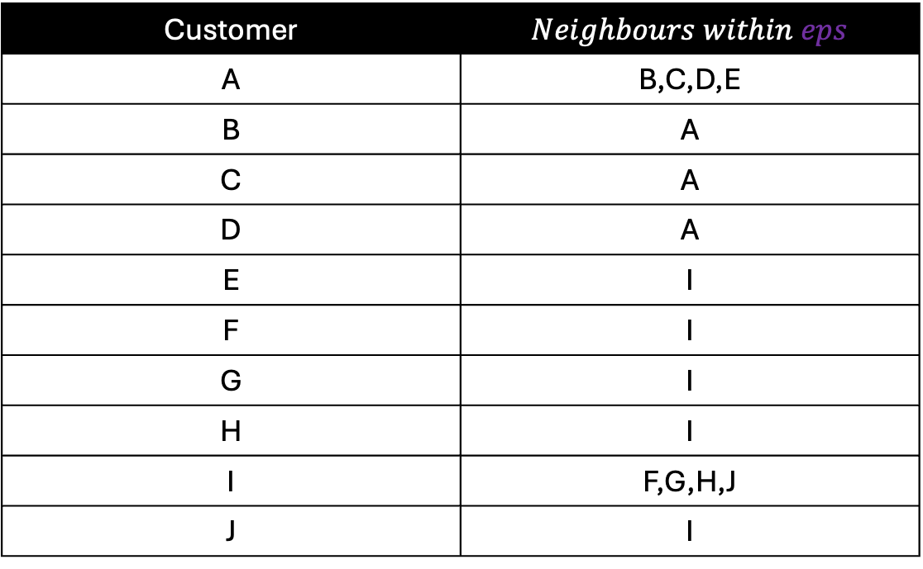
Customer | $Neighbours within eps$
A | B,C,D,E
B | A
C | A
D | A
E | I
F | I
G | I
H | I
I | F,G,H,J
J | I
Step 3: For each point, find its neighbours within the eps/radius.

Slide 73
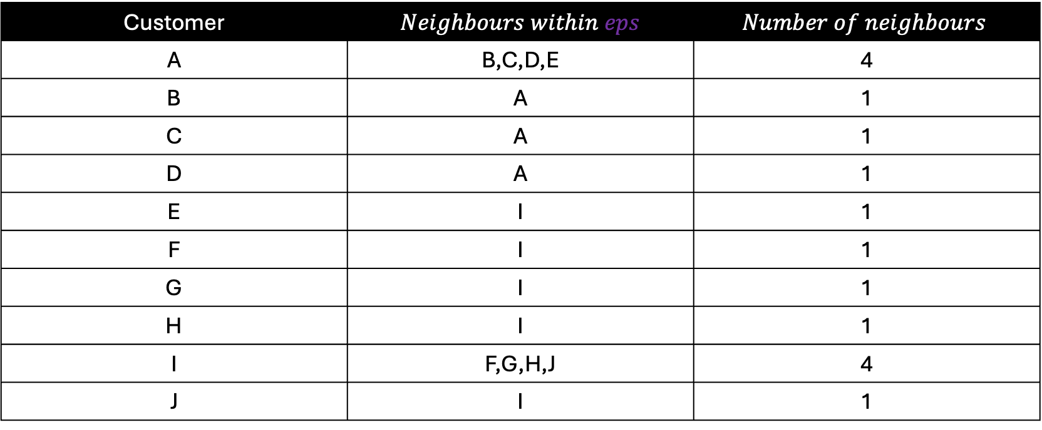
Customer | $Neighbours within eps$ | $$Number of neighbours$$
A | B,C,D,E | 4
B | A | 1
C | A | 1
D | A | 1
E | I | 1
F | I | 1
G | I | 1
H | I | 1
I | F,G,H,J | 4
J | I | 1
Step 4: Determine the core points. To be a core point, its number of neighbours must be greater than or equal to the min_samples

Slide 74
Customer | $Neighbours within eps$ | $$Number of neighbours$$
A | B,C,D,E | 4
B | A | 1
C | A | 1
D | A | 1
E | I | 1
F | I | 1
G | I | 1
H | I | 1
I | F,G,H,J | 4
J | I | 1
Step 4: Determine the core points. To be a core point, its number of neighbours must be greater than or equal to the min_samples

Slide 75
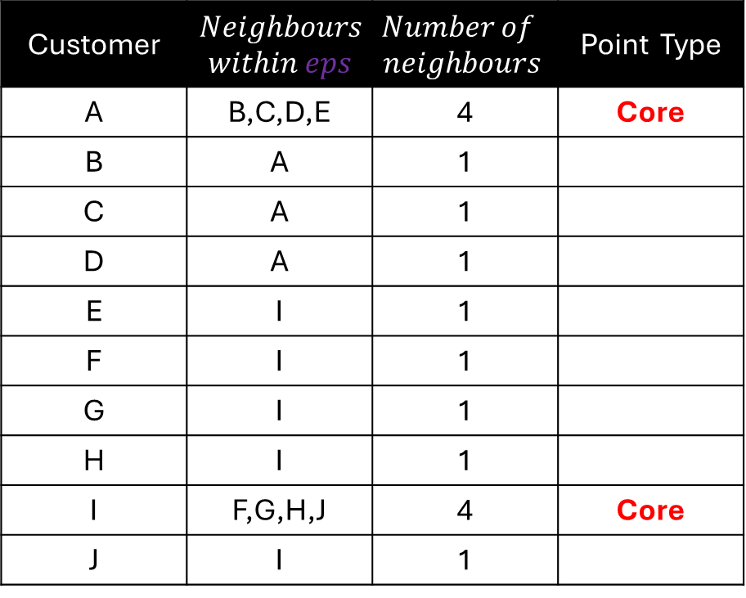
Customer | $$Neighbours$$ $within eps$ | $$Number of$$ $$neighbours$$ | Point Type
A | B,C,D,E | 4 | Core
B | A | 1
C | A | 1
D | A | 1
E | I | 1
F | I | 1
G | I | 1
H | I | 1
I | F,G,H,J | 4 | Core
J | I | 1
F
I
J
D
B
A
E
C
Step 4: Determine the core points. To be a core point, its number of neighbours must be greater than or equal to the min_samples

Slide 76
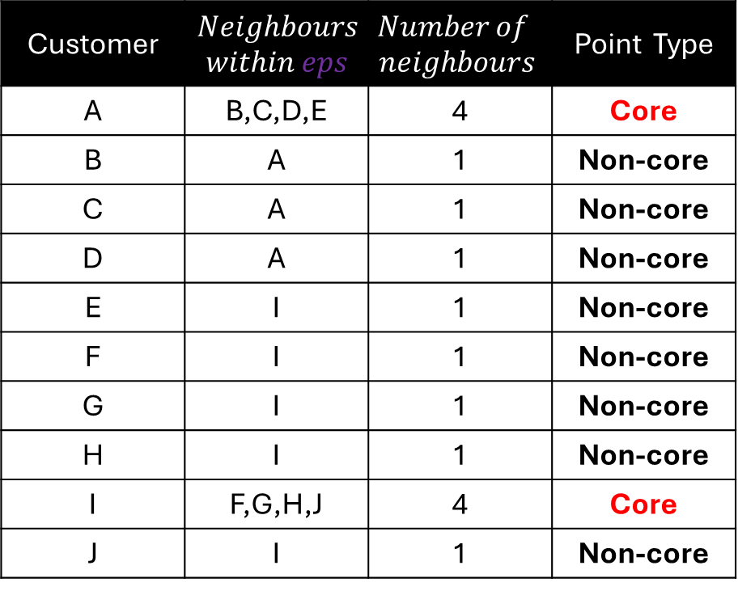
Customer | $$Neighbours$$ $within eps$ | $$Number of$$ $$neighbours$$ | Point Type
A | B,C,D,E | 4 | Core
B | A | 1 | Non-core
C | A | 1 | Non-core
D | A | 1 | Non-core
E | I | 1 | Non-core
F | I | 1 | Non-core
G | I | 1 | Non-core
H | I | 1 | Non-core
I | F,G,H,J | 4 | Core
J | I | 1 | Non-core
F
I
J
D
B
A
E
C
Step 5: Determine the non-core points. A data point will be a non-core point if its number of neighbours is less than the min_samples.

Slide 77
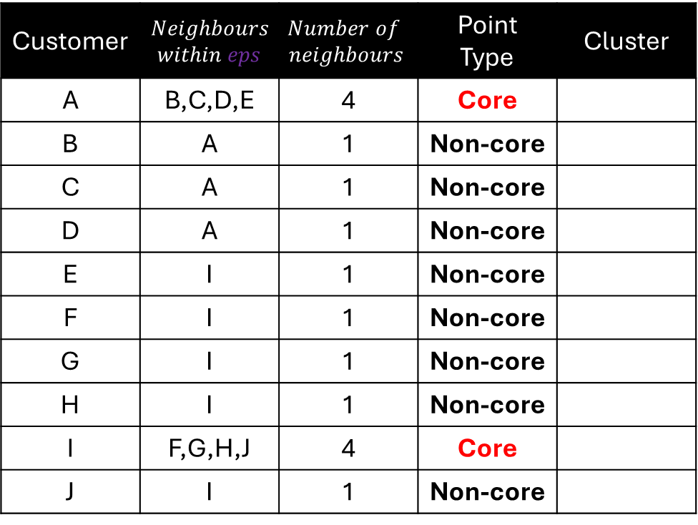
Customer | $$Neighbours$$ $within eps$ | $$Number of$$ $$neighbours$$ | Point Type | Cluster
A | B,C,D,E | 4 | Core
B | A | 1 | Non-core
C | A | 1 | Non-core
D | A | 1 | Non-core
E | I | 1 | Non-core
F | I | 1 | Non-core
G | I | 1 | Non-core
H | I | 1 | Non-core
I | F,G,H,J | 4 | Core
J | I | 1 | Non-core
F
I
J
D
B
A
E
C
Step 6: Randomly pick a core point and add it to the first cluster. Here we first select core point A.

Slide 78
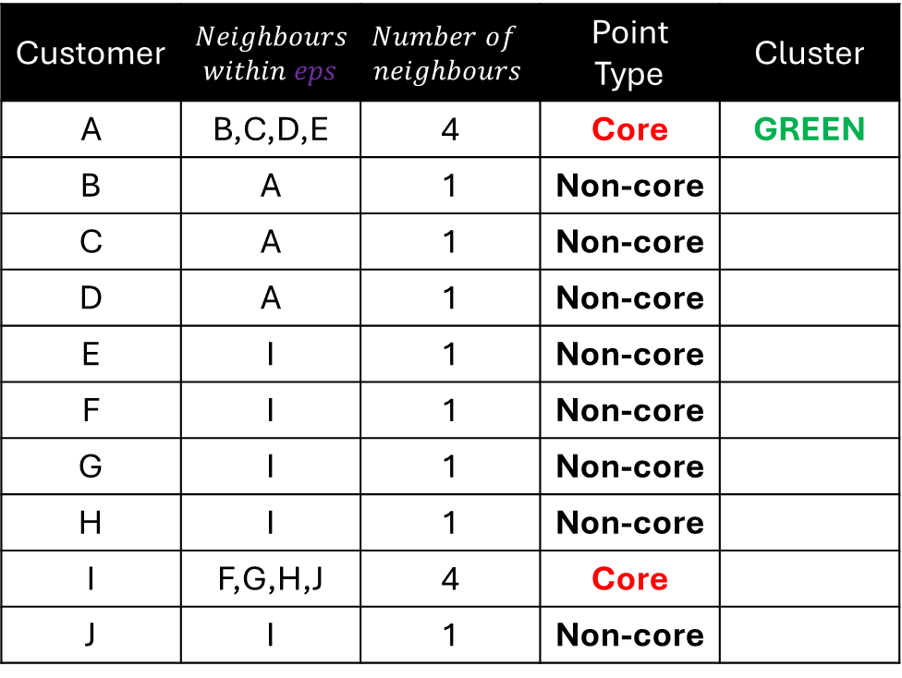
Customer | $$Neighbours$$ $within eps$ | $$Number of$$ $$neighbours$$ | Point Type | Cluster
A | B,C,D,E | 4 | Core | GREEN
B | A | 1 | Non-core
C | A | 1 | Non-core
D | A | 1 | Non-core
E | I | 1 | Non-core
F | I | 1 | Non-core
G | I | 1 | Non-core
H | I | 1 | Non-core
I | F,G,H,J | 4 | Core
J | I | 1 | Non-core
F
I
J
D
B
A
E
C
We then assign A to the first cluster.

Slide 79
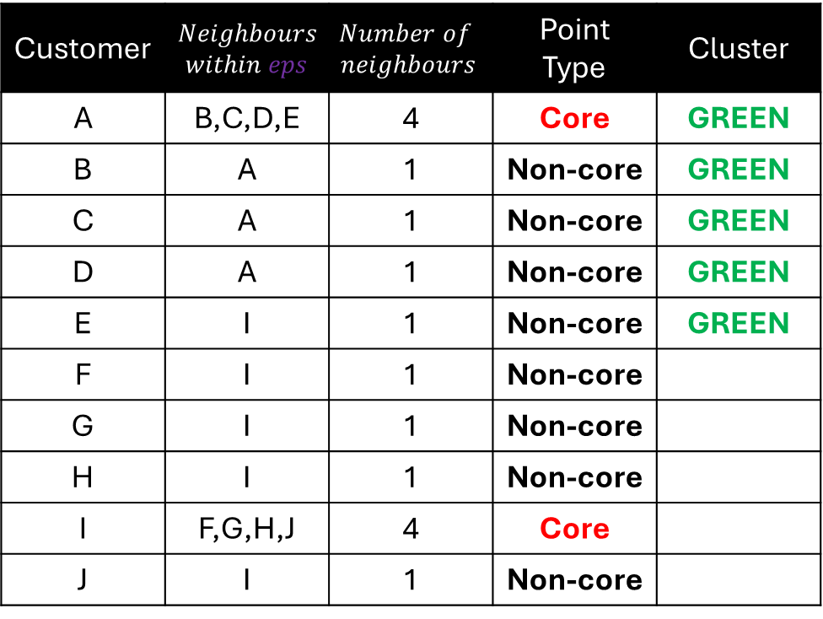
Customer | $$Neighbours$$ $within eps$ | $$Number of$$ $$neighbours$$ | Point Type | Cluster
A | B,C,D,E | 4 | Core | GREEN
B | A | 1 | Non-core | GREEN
C | A | 1 | Non-core | GREEN
D | A | 1 | Non-core | GREEN
E | I | 1 | Non-core | GREEN
F | I | 1 | Non-core
G | I | 1 | Non-core
H | I | 1 | Non-core
I | F,G,H,J | 4 | Core
J | I | 1 | Non-core
F
I
J
D
B
A
E
C
Expand the first cluster from A, we add B,C,D,E, to the first cluster

Slide 80
Customer | $$Neighbours$$ $within eps$ | $$Number of$$ $$neighbours$$ | Point Type | Cluster
A | B,C,D,E | 4 | Core | GREEN
B | A | 1 | Non-core | GREEN
C | A | 1 | Non-core | GREEN
D | A | 1 | Non-core | GREEN
E | I | 1 | Non-core | GREEN
F | I | 1 | Non-core
G | I | 1 | Non-core
H | I | 1 | Non-core
I | F,G,H,J | 4 | Core
J | I | 1 | Non-core
F
I
J
D
B
A
E
C
Move to point B, since B is a non-core point, we do not expand further

Slide 81
Customer | $$Neighbours$$ $within eps$ | $$Number of$$ $$neighbours$$ | Point Type | Cluster
A | B,C,D,E | 4 | Core | GREEN
B | A | 1 | Non-core | GREEN
C | A | 1 | Non-core | GREEN
D | A | 1 | Non-core | GREEN
E | I | 1 | Non-core | GREEN
F | I | 1 | Non-core
G | I | 1 | Non-core
H | I | 1 | Non-core
I | F,G,H,J | 4 | Core
J | I | 1 | Non-core
F
I
J
D
B
A
E
C
We then move to point C, D then E. Since they are all non-core points, we do not expand further.

Slide 82
Customer | $$Neighbours$$ $within eps$ | $$Number of$$ $$neighbours$$ | Point Type | Cluster
A | B,C,D,E | 4 | Core | GREEN
B | A | 1 | Non-core | GREEN
C | A | 1 | Non-core | GREEN
D | A | 1 | Non-core | GREEN
E | I | 1 | Non-core | GREEN
F | I | 1 | Non-core
G | I | 1 | Non-core
H | I | 1 | Non-core
I | F,G,H,J | 4 | Core
J | I | 1 | Non-core
F
I
J
D
B
A
E
C
We then move to point C, D then E. Since they are all non-core points, we do not expand further.

Slide 83
Customer | $$Neighbours$$ $within eps$ | $$Number of$$ $$neighbours$$ | Point Type | Cluster
A | B,C,D,E | 4 | Core | GREEN
B | A | 1 | Non-core | GREEN
C | A | 1 | Non-core | GREEN
D | A | 1 | Non-core | GREEN
E | I | 1 | Non-core | GREEN
F | I | 1 | Non-core
G | I | 1 | Non-core
H | I | 1 | Non-core
I | F,G,H,J | 4 | Core
J | I | 1 | Non-core
F
I
J
D
B
A
E
C
We then move to point C, D then E. Since they are all non-core points, we do not expand further.

Slide 84
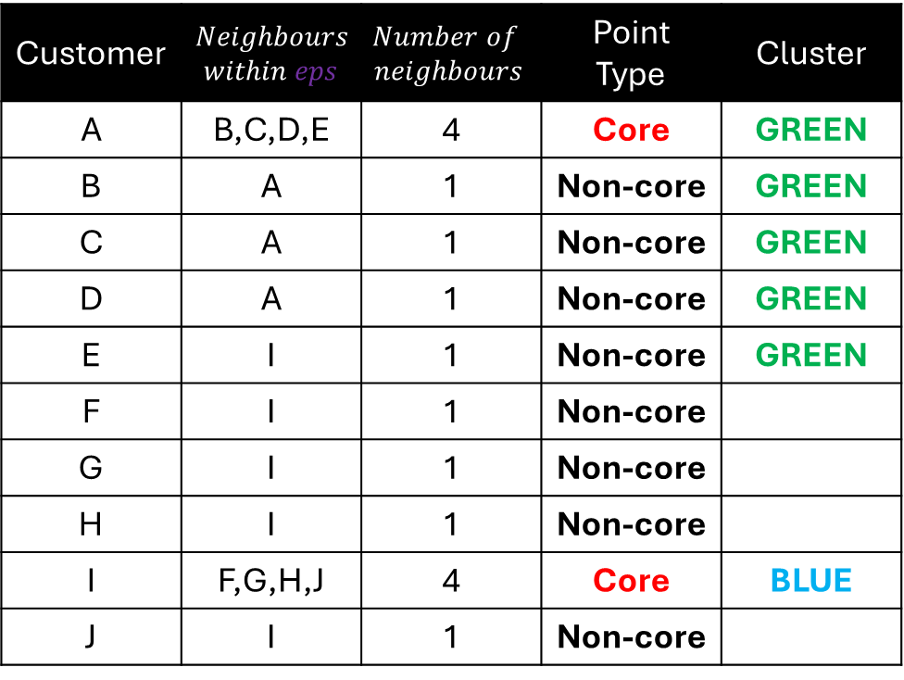
Customer | $$Neighbours$$ $within eps$ | $$Number of$$ $$neighbours$$ | Point Type | Cluster
A | B,C,D,E | 4 | Core | GREEN
B | A | 1 | Non-core | GREEN
C | A | 1 | Non-core | GREEN
D | A | 1 | Non-core | GREEN
E | I | 1 | Non-core | GREEN
F | I | 1 | Non-core
G | I | 1 | Non-core
H | I | 1 | Non-core
I | F,G,H,J | 4 | Core | BLUE
J | I | 1 | Non-core
F
I
J
D
B
A
E
C
For the remaining unvisited core points, start a second cluster.

Slide 85
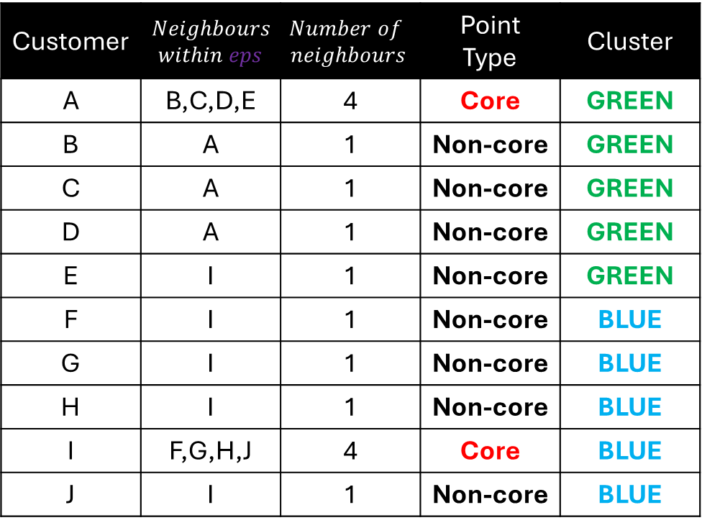
Customer | $$Neighbours$$ $within eps$ | $$Number of$$ $$neighbours$$ | Point Type | Cluster
A | B,C,D,E | 4 | Core | GREEN
B | A | 1 | Non-core | GREEN
C | A | 1 | Non-core | GREEN
D | A | 1 | Non-core | GREEN
E | I | 1 | Non-core | GREEN
F | I | 1 | Non-core | BLUE
G | I | 1 | Non-core | BLUE
H | I | 1 | Non-core | BLUE
I | F,G,H,J | 4 | Core | BLUE
J | I | 1 | Non-core | BLUE
F
I
J
D
B
A
E
C
Expand the second cluster from I. Add F,G,H,J, to the second cluster

Slide 86
Customer | $$Neighbours$$ $within eps$ | $$Number of$$ $$neighbours$$ | Point Type | Cluster
A | B,C,D,E | 4 | Core | GREEN
B | A | 1 | Non-core | GREEN
C | A | 1 | Non-core | GREEN
D | A | 1 | Non-core | GREEN
E | I | 1 | Non-core | GREEN
F | I | 1 | Non-core | BLUE
G | I | 1 | Non-core | BLUE
H | I | 1 | Non-core | BLUE
I | F,G,H,J | 4 | Core | BLUE
J | I | 1 | Non-core | BLUE
F
I
J
D
B
A
E
C
Move to point F. Since F is a non-core point, we do not expand the second cluster further

Slide 87
Customer | $$Neighbours$$ $within eps$ | $$Number of$$ $$neighbours$$ | Point Type | Cluster
A | B,C,D,E | 4 | Core | GREEN
B | A | 1 | Non-core | GREEN
C | A | 1 | Non-core | GREEN
D | A | 1 | Non-core | GREEN
E | I | 1 | Non-core | GREEN
F | I | 1 | Non-core | BLUE
G | I | 1 | Non-core | BLUE
H | I | 1 | Non-core | BLUE
I | F,G,H,J | 4 | Core | BLUE
J | I | 1 | Non-core | BLUE
F
I
J
D
B
A
E
C
We then move to point G, H then J. Since they are all non-core points, we do not expand further.

Slide 88
Customer | $$Neighbours$$ $within eps$ | $$Number of$$ $$neighbours$$ | Point Type | Cluster
A | B,C,D,E | 4 | Core | GREEN
B | A | 1 | Non-core | GREEN
C | A | 1 | Non-core | GREEN
D | A | 1 | Non-core | GREEN
E | I | 1 | Non-core | GREEN
F | I | 1 | Non-core | BLUE
G | I | 1 | Non-core | BLUE
H | I | 1 | Non-core | BLUE
I | F,G,H,J | 4 | Core | BLUE
J | I | 1 | Non-core | BLUE
F
I
J
D
B
A
E
C
We then move to point G, H then J. Since they are all non-core points, we do not expand further.

Slide 89
Customer | $$Neighbours$$ $within eps$ | $$Number of$$ $$neighbours$$ | Point Type | Cluster
A | B,C,D,E | 4 | Core | GREEN
B | A | 1 | Non-core | GREEN
C | A | 1 | Non-core | GREEN
D | A | 1 | Non-core | GREEN
E | I | 1 | Non-core | GREEN
F | I | 1 | Non-core | BLUE
G | I | 1 | Non-core | BLUE
H | I | 1 | Non-core | BLUE
I | F,G,H,J | 4 | Core | BLUE
J | I | 1 | Non-core | BLUE
F
I
J
D
B
A
E
C
We then move to point G, H then J. Since they are all non-core points, we do not expand further.

Slide 90
Customer | $$Neighbours$$ $within eps$ | $$Number of$$ $$neighbours$$ | Point Type | Cluster
A | B,C,D,E | 4 | Core | GREEN
B | A | 1 | Non-core | GREEN
C | A | 1 | Non-core | GREEN
D | A | 1 | Non-core | GREEN
E | I | 1 | Non-core | GREEN
F | I | 1 | Non-core | BLUE
G | I | 1 | Non-core | BLUE
H | I | 1 | Non-core | BLUE
I | F,G,H,J | 4 | Core | BLUE
J | I | 1 | Non-core | BLUE
F
I
J
D
B
A
E
C
Clustering with DBSCAN is complete ☺

Slide 91
K
F
I
J
D
B
A
E
C
L
Note: If we were to have points K and L located at these coordinates

Slide 92
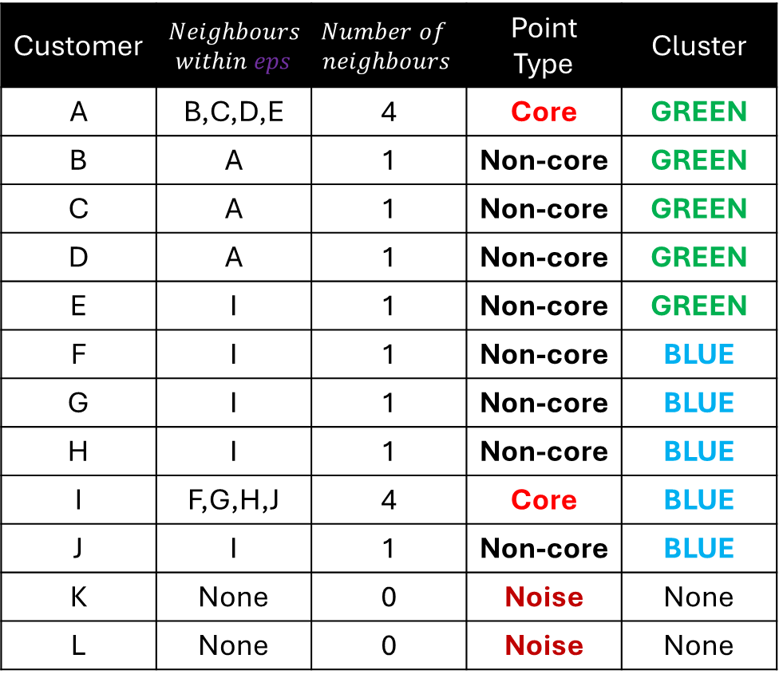
Customer | $$Neighbours$$ $within eps$ | $$Number of$$ $$neighbours$$ | Point Type | Cluster
A | B,C,D,E | 4 | Core | GREEN
B | A | 1 | Non-core | GREEN
C | A | 1 | Non-core | GREEN
D | A | 1 | Non-core | GREEN
E | I | 1 | Non-core | GREEN
F | I | 1 | Non-core | BLUE
G | I | 1 | Non-core | BLUE
H | I | 1 | Non-core | BLUE
I | F,G,H,J | 4 | Core | BLUE
J | I | 1 | Non-core | BLUE
K | None | 0 | Noise | None
L | None | 0 | Noise | None
K
F
I
J
D
B
A
E
C
L
Then we would label K and L as noise points which we also call outliers.

